Slide 1
String Matching
Pedro Szekely & Craig Knoblock
University of Southern California

Slide 2

Isn’t the Problem Solved?
String.equalsIgnoreCase(String x)
slide by Pedro Szekely

Slide 3

How Many Publications?
slide by Pedro Szekely

Slide 4

Why So Many?
slide by Pedro Szekely

Slide 5
Multiple John Singer Sargents?
dallas:John_Singer_Sargent
a foaf:Person;
:dateOfBirth "1856" ;
:dateOfDeath "1925" ;
:name "John Singer Sargent" .
ima:John_Singer_Sargent
a foaf:Person;
:dateOfBirth "1856" ;
:dateOfDeath "1925" ;
:name "John S. Sargent" .
slide by Pedro Szekely

Slide 6
Multiple John Singer Sargents?
dallas:John_Singer_Sargent
a foaf:Person;
:dateOfBirth "1856" ;
:dateOfDeath "1925" ;
:name "John Singer Sargent" .
string_match("John Singer Sargent”, "John S. Sargent”) = ???
ima:John_Singer_Sargent
a foaf:Person;
:dateOfBirth "1856" ;
:dateOfDeath "1925" ;
:name "John S. Sargent" .
slide by Pedro Szekely

Slide 7
String Matching Problem

Slide 8
myMatchFunction(x, y)
yourMatchFunction(x, y)
What does it mean that one is better than the other?
slide by Pedro Szekely

Slide 9
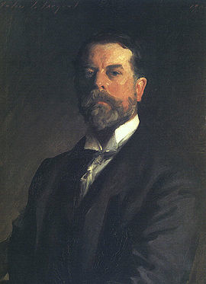
Problem Definition
Given X and Y sets of strings
Find pairs (x, y)
such that both x and y
refer to the same real world entity
"John S. Sargent"
"John Singer Sargent"
slide by Pedro Szekely

Slide 10
Problem Definition
Given X and Y sets of strings
Find pairs (x, y)
such that both x and y
refer to the same real world entity
We can use precision and recall to evaluate algorithms
slide by Pedro Szekely

Slide 11
Problem Definition
Given X and Y sets of strings
Find pairs (x, y)
such that both x and y
refer to the same real world entity
fraction of pairs found that are correct
We can use precision and recall to evaluate algorithms
fraction of pairs found
slide by Pedro Szekely

Slide 12
Why Strings Don’t Match Perfectly?
typos
"Joh” vs “John”
OCR errors
"J0hn” vs “John”
formatting conventions
”03/17” vs “March 17”
abbreviations
”J. S. Sargent” vs “John Singer Sargent”
nick names
”John” vs “Jock”
word order
”Sargent, John S.” vs “John S. Sargent”
slide by Pedro Szekely

Slide 13
Similiarity Measure
Similiarity
s(x, y) in [0, 1]
better
Distance
d(x, y) in [0, ∞)
slide by Pedro Szekely

Slide 14
Types of Similarity Metrics
Sequence based
Set based
Hybrid
Phonetic
slide by Pedro Szekely

Slide 15
Sequence Based Metrics

Slide 16
Edit Distance
"J0n Singer Sargent"
insert character
delete character
substitute character
transpose character
…
"John S. Sargent"
slide by Pedro Szekely

Slide 17
Edit Distance
costs
"J0n Singer Sargent"
c₁
insert character
c₂
delete character
c₃
substitute character
c₄
transpose character
c_{i}
…
"John S. Sargent"
slide by Pedro Szekely

Slide 18
Edit Distance
costs
"J0n Singer Sargent"
c₁
insert character
c₂
delete character
Σc_{i}
c₃
substitute character
c₄
transpose character
c_{i}
…
"John S. Sargent"
slide by Pedro Szekely

Slide 19
Levenshtein Distance
costs
Edit distance:
1
insert character
1
delete character
1
substitute character
lev(x, y) is the minimum cost to transform x to y
Online calculator: http://planetcalc.com/1721/
slide by Pedro Szekely

Slide 20
Computing Levenshtein Distance
lev(x, y) is the minimum cost to transform x to y
Definitions
x = x₁x₂ … x_{n}
y = y₁y₂ … y_{m}
d(i,j) = lev(x₁x₂ … x_{i}, y₁y₂ … y_{j})
d(0,0) = lev(“”,“”) = 0
We want d(n, m)
slide by Pedro Szekely

Slide 21
Computing Levenshtein Distance
d(0,0) = 0
slide by Pedro Szekely

Slide 22
Computing Levenshtein Distance
d(0,0) = 0
x₁x₂ … x_{i-1}x_{i} is a suffix of x
y₁y₂ … y_{j-1}y_{j} is a suffix of y
slide by Pedro Szekely

Slide 23
Computing Levenshtein Distance
d(0,0) = 0
x₁x₂ … x_{i-1}x_{i} is a prefix of x
y₁y₂ … y_{j-1}y_{j} is a prefix of y
Case
Distance
Operation
x_{i} = y_{j}
d(i-1,j-1)
keep x_{i}
slide by Pedro Szekely

Slide 24
Computing Levenshtein Distance
d(0,0) = 0
x₁x₂ … x_{i-1}x_{i} is a prefix of x
y₁y₂ … y_{j-1}y_{j} is a prefix of y
Case
Distance
Operation
x_{i} = y_{j}
d(i-1,j-1)
keep x_{i}
x_{i} != y_{j}
delete x_{i}
insert y_{j} after x_{i}
replace x_{i} with y_{j}
slide by Pedro Szekely

Slide 25
Computing Levenshtein Distance
d(0,0) = 0
x₁x₂ … x_{i-1}x_{i} is a prefix of x
y₁y₂ … y_{j-1}y_{j} is a prefix of y
Case
Distance
Operation
x_{i} = y_{j}
d(i-1,j-1)
keep x_{i}
x_{i} != y_{j}
d(i-1,j) + 1
delete x_{i}
insert y_{j} after x_{i}
replace x_{i} with y_{j}
slide by Pedro Szekely

Slide 26
Computing Levenshtein Distance
d(0,0) = 0
x₁x₂ … x_{i-1}x_{i} is a prefix of x
y₁y₂ … y_{j-1}y_{j} is a prefix of y
Case
Distance
Operation
x_{i} = y_{j}
d(i-1,j-1)
keep x_{i}
x_{i} != y_{j}
d(i-1,j) + 1
delete x_{i}
d(i,j-1) + 1
insert y_{j} after x_{i}
replace x_{i} with y_{j}
slide by Pedro Szekely

Slide 27
Computing Levenshtein Distance
d(0,0) = 0
x₁x₂ … x_{i-1}x_{i} is a prefix of x
y₁y₂ … y_{j-1}y_{j} is a prefix of y
Case
Distance
Operation
x_{i} = y_{j}
d(i-1,j-1)
keep x_{i}
x_{i} != y_{j}
d(i-1,j) + 1
delete x_{i}
d(i,j-1) + 1
insert y_{j} after x_{i}
d(i-1,j-1) + 1
replace x_{i} with y_{j}
slide by Pedro Szekely

Slide 28
Computing Levenshtein Distance
d(0,0) = 0
x₁x₂ … x_{i-1}x_{i} is a prefix of x
y₁y₂ … y_{j-1}y_{j} is a prefix of y
Case
Distance
Operation
x_{i} = y_{j}
d(i-1,j-1)
keep x_{i}
x_{i} != y_{j}
d(i-1,j) + 1
delete x_{i}
d(i,j-1) + 1
insert y_{j} after x_{i}
d(i-1,j-1) + 1
replace x_{i} with y_{j}
d(i,j) = minimum
slide by Pedro Szekely

Slide 29
Computing Levenshtein Distance Using Dynamic Programming
x = dva, y = dave
y0 y1 y2 y3 y4
y0 y1 y2 y3 y4
 |  | d | a | v | e
 | 0 | 1 | 2 | 3 | 4
d | 1 | 0 | 1
v | 2
a | 3
 |  | d | a | v | e
 | 0 | 1 | 2 | 3 | 4
d | 1 | 0 | 1 | 2 | 3
v | 2 | 1 | 1 | 1 | 2
a | 3 | 2 | 1 | 2 | 2
x = d – v a
y = d a v e
x0
x0
x1
x1
substitute a with e
insert a (after d)
x2
x2
x3
x3
Cost of dynamic programming is O(|x||y|)
slide from Anhai Doan, Alon Halevy, Zachary Ives

Slide 30
Levenshtein Distance Complexity
Dynamic programming algorithm
Time Complexity = O (N * M), Space Complexity = O (N * M)
Polylogarithmic Approximation for Edit Distance and the Asymmetric Query Complexity
Alexandr Andoni, Robert Krauthgamer, Krzysztof Onak
We present a near-linear time algorithm that approximates the edit distance between two strings within a polylogarithmic factor; specifically, for strings of length n and every fixed epsilon>0, it can compute a
(log n)^{O(1/epsilon)} approximation in n^{(1+epsilon)} time.
http://arxiv.org/abs/1005.4033
slide by Pedro Szekely

Slide 31
Levenshtein Distance Examples
lev(John Singer Sargent,
John S. Sargent)
=
slide by Pedro Szekely

Slide 32
Levenshtein Distance Examples
lev(John Singer Sargent,
John S. Sargent)
=
5
slide by Pedro Szekely

Slide 33
Levenshtein Distance Examples
lev(John Singer Sargent,
John S. Sargent)
=
5
lev(John Singer Sargent,
Jane Klinger Sargent)
=
slide by Pedro Szekely

Slide 34
Levenshtein Distance Examples
lev(John Singer Sargent,
John S. Sargent)
=
5
lev(John Singer Sargent,
Jane Klinger Sargent)
=
5
slide by Pedro Szekely

Slide 35
Levenshtein Distance Examples
Too high a cost for deleting a sequence of characters
lev(John Singer Sargent,
John S. Sargent)
=
5
lev(John Singer Sargent,
Jane Klinger Sargent)
=
5
slide by Pedro Szekely

Slide 36
Needleman-Wunch Measure
Generalization of levenstein(x, y)
nw(John Singer Sargent,
John S. Sargent)
alignments
gaps
slide by Pedro Szekely

Slide 37
Needleman-Wunch Measure
Generalization of levenstein(x, y)
nw(John Singer Sargent,
John S. Sargent)
alignments
gaps
s ( c_{i} , c_{j} )
alignment
score
matrix
slide by Pedro Szekely

Slide 38
Needleman-Wunch Measure
Generalization of levenstein(x, y)
nw(John Singer Sargent,
John S. Sargent)
alignments
gaps
s ( c_{i} , c_{j} )
Alignment
score
matrix
gap score
slide by Pedro Szekely

Slide 39
Needleman-Wunch Measure
Generalization of levenstein(x, y)
nw(John Singer Sargent,
John S. Sargent)
2 if c_{i} = c_{j}
-1 if c_{i} != c_{j}
s ( c_{i} , c_{j} ) =
gap-score = -0.5
slide by Pedro Szekely

Slide 40
Needleman-Wunch Measure
Generalization of levenstein(x, y)
nw(John Singer Sargent,
John S. Sargent)
2 * 14 + (-1) * 1 + (-0.5) * 4 = 25
2 if c_{i} = c_{j}
-1 if c_{i} != c_{j}
s ( c_{i} , c_{j} ) =
gap-score = -0.5
slide by Pedro Szekely

Slide 41
Comparison
 | Levenshtein | Needleman-Wunch
Costs | 1 | matrix
Operations | insert/delete | gaps
Result | distance | similarity
OCR errors
"J0hn” vs “John”
lower penalty
score(o,0) = -0.2
score(m,0) = -1.0
slide by Pedro Szekely

Slide 42
Needleman-Wunch Example
nw(John Singer Sargent,
John S. Sargent)
2 * 14 + (-1) * 1 + (-0.5) * 4 = 25
2 * 14 + (-1) * 3 + (-0.5) * 1 = 24.5
nw(John S inger Sargent,
Jane Klinger Sargent)
slide by Pedro Szekely

Slide 43
Needleman-Wunch Example
nw(John Singer Sargent,
John S. Sargent)
2 * 14 + (-1) * 1 + (-0.5) * 4 = 25
2 * 14 + (-1) * 1 + (-0.5) * 8 = 23
nw(John Stanislaus Sargent,
John S. Sargent)
slide by Pedro Szekely

Slide 44
Needleman-Wunch Example
nw(John Singer Sargent,
John S. Sargent)
Longer gaps are penalized more
Bad for names
2 * 14 + (-1) * 1 + (-0.5) * 4 = 25
2 * 14 + (-1) * 1 + (-0.5) * 8 = 23
nw(John Stanislaus Sargent,
John S. Sargent)
slide by Pedro Szekely

Slide 45
Affine Gap Measure
Generalization of needleman-wunch(x, y)
nw(John Singer Sargent,
John S. Sargent)
continue gap, cost
c_{r}
open gap, cost
c_{o}
slide by Pedro Szekely

Slide 46
Affine Gap Measure
Generalization of needleman-wunch(x, y)
nw(John Singer Sargent,
John S. Sargent)
Alignment
score
matrix
continue gap, cost
c_{r}
s ( c_{i} , c_{j} )
open gap, cost
c_{o}
total gap cost:
c_{o} + (|gap| - 1) * c_{r}
slide by Pedro Szekely

Slide 47
Smith-Waterman
Global alignment
fully align sequences, opening gaps as needed
F T F T A L I L L A V A V
F - - T A L – L L A – A V
Needleman-Wunch
Local alignment
find best subsequences to align
F T F T A L I L L A V A V
- - F T A L – L L A V - -
Smith-Waterman: local alignment version of Needleman-Wunch
slide by Pedro Szekely

Slide 48
Smith-Waterman Example
match(John Sargent, american painter,
American artist John S. Sargent)
nw( John S argent, american painter,
American artist John S. Sargent )
Needleman-Wunch: significant gap penalty
slide by Pedro Szekely

Slide 49
Smith-Waterman Example
match(John Sargent, american painter,
American artist John S. Sargent)
nw( John S argent, american painter,
American artist John S. Sargent )
Needleman-Wunch: significant gap penalty
slide by Pedro Szekely

Slide 50
Smith-Waterman Example
match(John Sargent, american painter,
American artist John S. Sargent)
nw( John S argent, american painter,
American artist John S. Sargent )
Needleman-Wunch: significant gap penalty
sw( John S argent, american painter,
American artist John S. Sargent )
Smith-Waterman: identifies similar subsequences
slide by Pedro Szekely

Slide 51
Jaro Similarity Measure
Get points for having characters in common
but only if they are “close by”
Get points for common characters in the same order
lose points for transpositions
slide by Pedro Szekely

Slide 52
Jaro Similarity Measure
jaro(x, y)
max( |x| , |y| )
max-distance =
- 1
2
x_{i} = y_{j}
x_{i} matches y_{j} if
|i – j| <= max-distance
m = number of matching characters
t = number of transpositions
(of matching characters)
slide by Pedro Szekely

Slide 53
Jaro Similarity Measure
max( |x| , |y| )
max-distance =
- 1
2
m = number of matching characters
t = number of transpositions
0 if m = 0
jaro(x, y) =
1
(
m
m
m - t
)
+
+
3
|x|
|y|
m
slide by Pedro Szekely

Slide 54
Jaro Example
lev(DIXON, DICKSONX) = 4 (4/8 = 0.5)
jaro(DIXON, DICKSONX) = ???
slide by Pedro Szekely

Slide 55
Jaro Example
D I X O N
D 1 0 0 0 0
I 0 1 0 0 0
C 0 0 0 0 0
K 0 0 0 0 0
S 0 0 0 0 0
O 0 0 0 1 0
N 0 0 0 0 1
X 0 0 1 0 0
slide by Pedro Szekely

Slide 56
Jaro Example
|x| = 5
D I X O N
D 1 0 0 0 0
I 0 1 0 0 0
C 0 0 0 0 0
K 0 0 0 0 0
S 0 0 0 0 0
O 0 0 0 1 0
N 0 0 0 0 1
X 0 0 0 0 0
|y| = 8
max-distance
= (8/2) – 1
= 3
m = 4
t = 0
slide by Pedro Szekely

Slide 57
Jaro Example
|x| = 5
D I X O N
D 1 0 0 0 0
I 0 1 0 0 0
C 0 0 0 0 0
K 0 0 0 0 0
S 0 0 0 0 0
O 0 0 0 1 0
N 0 0 0 0 1
X 0 0 0 0 0
|y| = 8
m = 4
t = 0
= 0.767
slide by Pedro Szekely

Slide 58
Jaro Example
lev(DIXON, DICKSONX) = 4 (4/8 = 0.5)
jaro(DIXON, DICKSONX) = 0.767
slide by Pedro Szekely

Slide 59
Jaro-Winkler Measure
Give a bonus if there is a common prefix
jwProximity(x,y,boostThreshold,prefixSize)
= jaro(x,y) <= boostThreshold
? jaro (x,y)
: jaro (x,y)
+ 0.1 * prefixMatch(x,y,prefixSize)
* (1.0 - jaro(x,y))
prefixMatch(x,y,prefixSize) =
min(prefixSize, common-prefix(x,y))
boostThreshold = 0.7
prefixSize = 4
slide by Pedro Szekely

Slide 60
Jaro-Winkler Measure
jwProximity(x,y,boostThreshold,prefixSize)
= jaro(x,y) <= boostThreshold
? jaro (x,y)
: jaro (x,y)
+ 0.1 * prefixMatch(x,y,prefixSize)
* (1.0 - jaro(x,y))
boostThreshold = 0.7
prefixSize = 4
jaro(DIXON, DICKSONX) = 0.767
jwProximity(DIXON, DICKSONX) = 0.767 + 0.1*2*(1 – 0.767)
= 0.767 + 0.2*0.233
= 0.767 + 0.0466
= 0.8136
slide by Pedro Szekely

Slide 61
Set-Based Metrics

Slide 62
Set-Based Metrics
Generate set of tokens from the strings
Measure similarity between the sets of tokens
slide by Pedro Szekely

Slide 63
Tokenizing a String
Words
slide by Pedro Szekely

Slide 64
Tokenizing a String
Words
q-grams: substrings of length q
“david smith” 3-grams
{##d, #da, dav, avi, …, h##}
slide by Pedro Szekely

Slide 65
Jaccard Measure
B_{x} = tokens(x)
B_{y} = tokens(y)
|B_{x} B_{y}|
jaccard(x,y) =
|B_{x} B_{y}|
jaccard(dave, dav)
B_{x} = {#d, da, av, ve, e#}
B_{y} = {#d, da, av, v#}
jaccard(x,y) = 3/6
slide by Pedro Szekely

Slide 66
TF/IDF Measure
TF = term frequency
IDF = inverse document frequency
x = Apple Corporation, CA y = IBM Corporation, CA z = Apple Corp
…
blah blah Corporation
>
=
<
lev(x, y) lev(x, z)
???
slide by Pedro Szekely

Slide 67
TF/IDF Measure
TF = term frequency
IDF = inverse document frequency
x = Apple Corporation, CA y = IBM Corporation, CA z = Apple Corp
…
blah blah Corporation
>
lev(x, y) lev(x, z)
… but intuitively (x, z) is a better match
slide by Pedro Szekely

Slide 68
TF/IDF Measure
TF = term frequency
IDF = inverse document frequency
frequent term
should not carry
as much weight
x = Apple Corporation, CA y = IBM Corporation, CA z = Apple Corp
…
blah blah Corporation
>
lev(x, y) lev(x, z)
… but intuitively (x, z) is a better match
slide by Pedro Szekely

Slide 69
TF/IDF Measure
TF = term frequency
IDF = inverse document frequency
frequent term
should not carry
as much weight
x = Apple Corporation, CA y = IBM Corporation, CA z = Apple Corp
…
blah blah Corporation
distinguishing term
should carry
more weight
>
lev(x, y) lev(x, z)
… but intuitively (x, z) is a better match
slide by Pedro Szekely

Slide 70
Term Frequencies and Inverse Document Frequencies
Assume x and y are taken from a collection of strings
Each string is converted into a bag of terms called a document
term frequency tf(t,d) =
number of times term t appears in document d
inverse document frequency idf(t) =
N / N_{d}, number of documents in collection divided by number of documents that contain t
note: in practice, idf(t) is often defined as log(N / N_{d})
slide from Anhai Doan, Alon Halevy, Zachary Ives

Slide 71
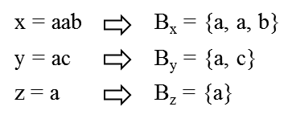
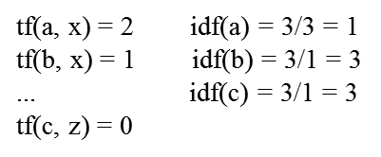
Example
slide from Anhai Doan, Alon Halevy, Zachary Ives

Slide 72
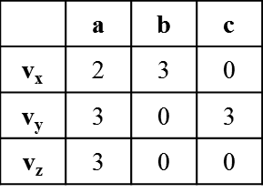
Feature Vectors
Each document d is converted into a feature vector v_{d}
v_{d} has a feature v_{d}(t) for each term t
value of v_{d}(t) is a function of TF and IDF scores
here we assume v_{d}(t) = tf(t,d) * idf(t)
slide from Anhai Doan, Alon Halevy, Zachary Ives

Slide 73
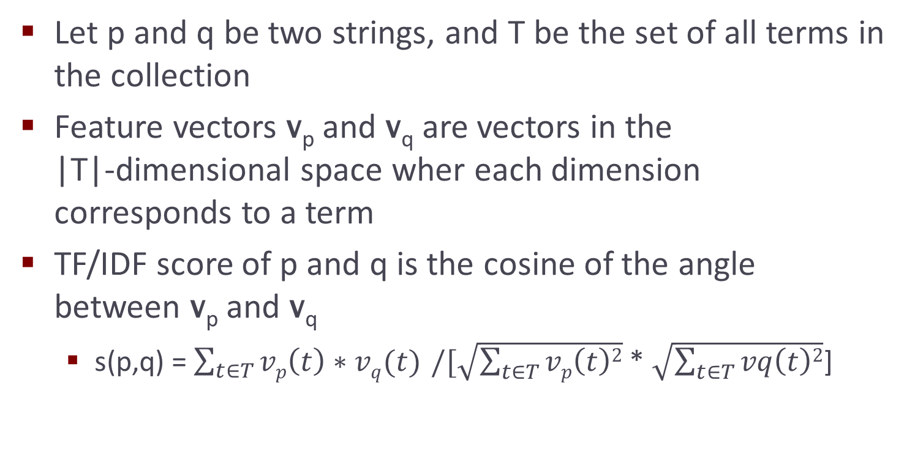
TF/IDF Similarity Score
slide from Anhai Doan, Alon Halevy, Zachary Ives

Slide 74
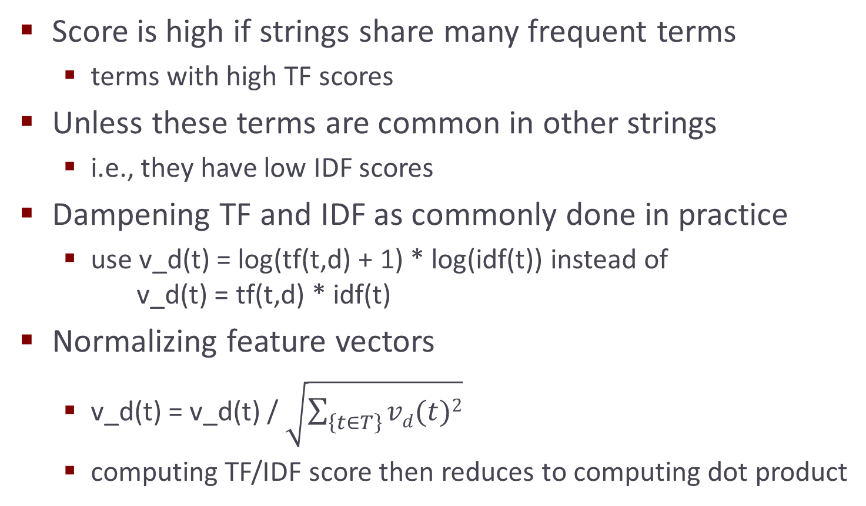
TF/IDF Similarity Score
slide from Anhai Doan, Alon Halevy, Zachary Ives

Slide 75
Hybrid Similarity Measures

Slide 76
Hybrid Measures
Do the set-based thing
but
use a similiarity metric for each element of the set
x = Apple Corporation, CA y = IBM Corporation, CA z = Aple Corp
…
blah blah Corporation
Aple mispelt
slide by Pedro Szekely

Slide 77
Generalized Jaccard Measure
Jaccard measure
considers overlapping tokens in both x and y
a token from x and a token from y must be identical to be included in the set of overlapping tokens
this can be too restrictive in certain cases
Example:
matching taxonomic nodes that describe companies
“Energy & Transportation” vs. “Transportation, Energy, & Gas”
in theory Jaccard is well suited here, in practice Jaccard may not work well if tokens are commonly misspelled
e.g., energy vs. eneryg
generalized Jaccard measure can help such cases
slide from Anhai Doan, Alon Halevy, Zachary Ives

Slide 78
Generalized Jaccard Measure
Let B_{x} = {x₁, …, x_{n}}, B_{y} = {y₁, …, y_{m}}
Step 1: find token pairs that will be in the “softened” overlap set
apply a similarity measure s to compute sim score for each pair (x_{i}, y_{j})
keep only those score > a given threshold α, this forms a bipartite graph G
find the maximum-weight matching M in G
Step 2: return normalized weight of M as generalized Jaccard score
GJ(x,y) = ∑ _{(xi,yj) in M} s(x_{i},y_{j}) / (|B_{x}| + |B_{y}| - |M|)
slide from Anhai Doan, Alon Halevy, Zachary Ives

Slide 79
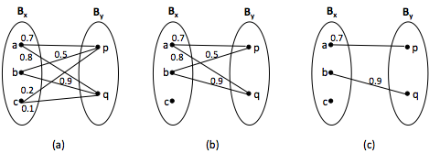
Generalized Jaccard Example
α = 0.5
Generalized Jaccard score: (0.7 + 0.9)/(3 + 2 – 2) = 0.53
slide from Anhai Doan, Alon Halevy, Zachary Ives

Slide 80
The Soft TF/IDF Measure
Similar to generalized Jaccard measure, except that it uses TF/IDF measure as the “higher-level” sim measure
e.g., “Apple Corporation, CA”, “IBM Corporation, CA”, and “Aple Corp”, with Apple being misspelled
Step 1: compute close(x,y,k): set of all terms t ϵ B_{x} that have at least one close term u ϵ B_{y}, i.e., s’(t,u) >= k
s’ is a basic sim measure (e.g., Jaro-Winkler), k prespecified
Step 2: compute s(x,y) as in traditional TF/IDF score, but weighing each TF/IDF component using s’
s(x,y) = ∑ _{tϵ close(x,y,k)} v_{x}(t) * v_{y}(u*) * s’(t,u*)
u*ϵ B_{y} maximizes s’(t,u) ∀ uϵ B_{y}

Slide 81
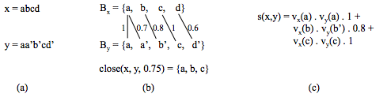
Soft TF/IDF Example
slide from Anhai Doan, Alon Halevy, Zachary Ives

Slide 82
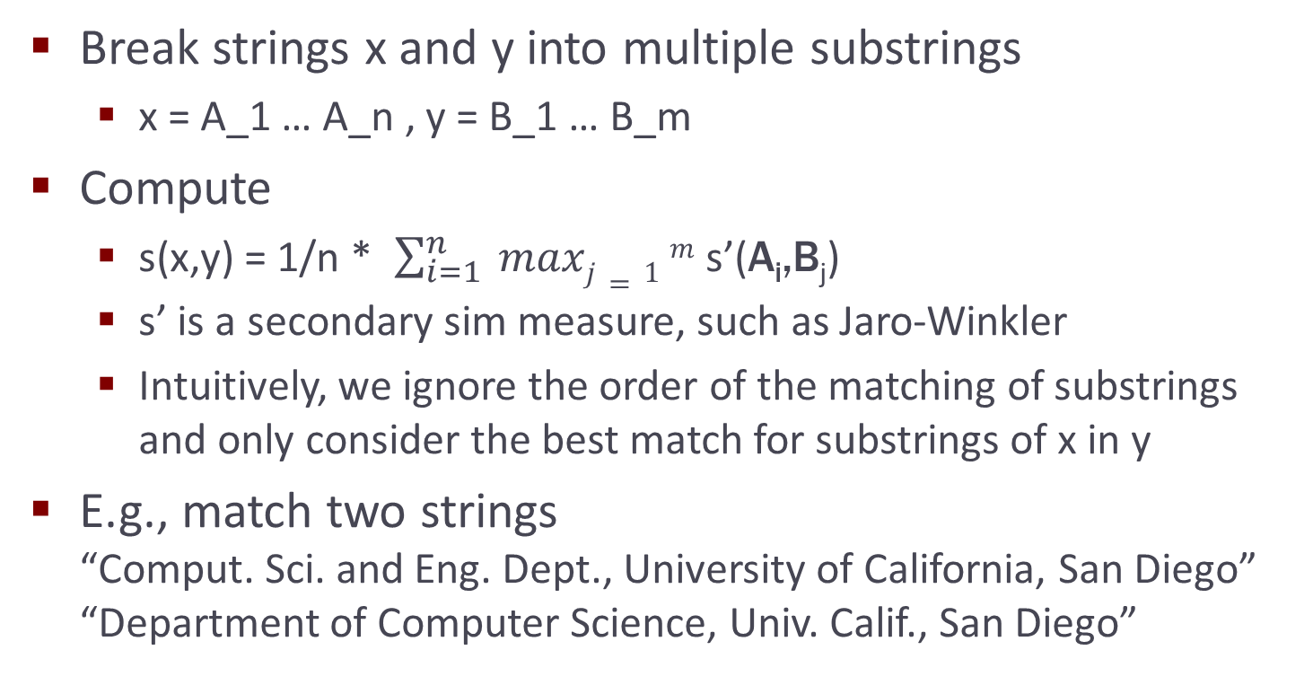
Monge-Elkan Measure
slide from Anhai Doan, Alon Halevy, Zachary Ives

Slide 83

Monge-Elkan Measure
x = A₁A₂
y = B₁B₂B₃
max( s’(A₁,B₁), s’(A₁,B₂), s’(A₁,B₃) )
+
max( s’(A₂,B₁), s’(A₂,B₂), s’(A₂,B₃))
2
s’ could be any metric, e.g., levenshtein
slide by Pedro Szekely

Slide 84
Monge-Elkan Measure
x = Comput. Sci. and Eng. Dept., University of California, San Diego
y = Department of Computer Science, Univ. of Calif., San Diego
what s’ should we use?
levenshtein
needleman-wunch
affine-gap
smith-waterman
jaro
jaro-winkler
slide by Pedro Szekely

Slide 85
Phonetic Similarity Measures

Slide 86
Phonetic Similarity Measures
Match strings based on their sound, instead of appearances
Very effective in matching names, which often appear in different ways that sound the same
e.g., Meyer, Meier, and Mire; Smith, Smithe, and Smythe
Soundex is most commonly used
slide from Anhai Doan, Alon Halevy, Zachary Ives

Slide 87
The Soundex Measure
Used primarily to match surnames
maps a surname x into a 4-letter code
two surnames are judged similar if share the same code
Algorithm to map x into a code:
Step 1: keep the first letter of x, subsequent steps are performed on the rest of x
Step 2: remove all occurences of W and H. Replace the remaining letters with digits as follows:
replace B, F, P, V with 1, C, G, J, K, Q, S, X, Z with 2, D, T with 3, L with 4, M, N with 5, R with 6
Step 3: replace sequence of identical digits by the digit itself
Step 4: Drop all non-digit letters, return the first four letters as the soundex code
slide from Anhai Doan, Alon Halevy, Zachary Ives

Slide 88
The Soundex Measure
Example: x = Ashcraft
after Step 2: A226a13, after Step 3: A26a13, Step 4 converts this into A2613, then returns A261
Soundex code is padded with 0 if there is not enough digits
Example: Robert and Rupert map into R163
Soundex fails to map Gough and Goff, and Jawornicki and Yavornitzky
designed primarily for Caucasian names, but found to work well for names of many different origins
does not work well for names of East Asian origins
which uses vowels to discriminate, Soundex ignores vowels
slide from Anhai Doan, Alon Halevy, Zachary Ives

Slide 89
Other Readings
http://en.wikipedia.org/wiki/String_metric
http://en.wikipedia.org/wiki/Approximate_string_matching
http://en.wikipedia.org/wiki/Edit_distance
http://en.wikipedia.org/wiki/Levenshtein_distance
http://en.wikipedia.org/wiki/Jaro–Winkler_distance
http://en.wikipedia.org/wiki/Smith–Waterman_algorithm
http://en.wikipedia.org/wiki/Jaccard_index
http://alias-i.com/lingpipe/demos/tutorial/stringCompare/read-me.html
http://www.gettingcirrius.com/2011/01/calculating-similarity-part-2-jaccard.html
http://en.wikipedia.org/wiki/Sequence_alignment#Pairwise_alignment
slide by Pedro Szekely

Slide 90
Software
http://code.google.com/p/java-similarities/source/browse/trunk/simmetrics/src/main/java/uk/ac/shef/wit/simmetrics/
http://sourceforge.net/projects/secondstring/
http://planetcalc.com/1721/ (Levenshtein calculator)
slide by Pedro Szekely

Slide 91
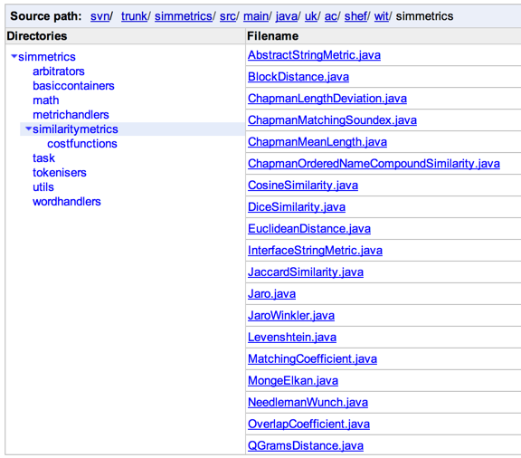
slide by Pedro Szekely

